Slide 1

CORONA VIRUS
ANALYSIS
YEAR 2020 & 2021 USING SQL
OLAYINKA VICTOR

Slide 2
TABLE OF CONTENT
01
INTRODUCTION
02
PROBLEM STATEMENT
03
DATA OVERVIEW
04
DATA EXPLORATION

Slide 3
INTRODUCTION
Coronavirus disease (COVID-19) is a highly contagious respiratory disease caused by the novel coronavirus SARS-CoV-2, first identified in Wuhan, China, in late 2019. The virus spreads primarily through respiratory droplets and can cause symptoms ranging from mild to severe, including fever, cough, and difficulty breathing. It led to a global pandemic, prompting widespread public health measures such as lockdowns, social distancing, and mask-wearing.

Slide 4
PROBLEM STATEMENT
The CORONA VIRUS pandemic has had a significant impact on public health and has created an urgent need for data driven insights in understanding the spread of the virus. This analysis uses SQL to present key insights of its global spread globally in year 2020 & 2021.

Slide 5

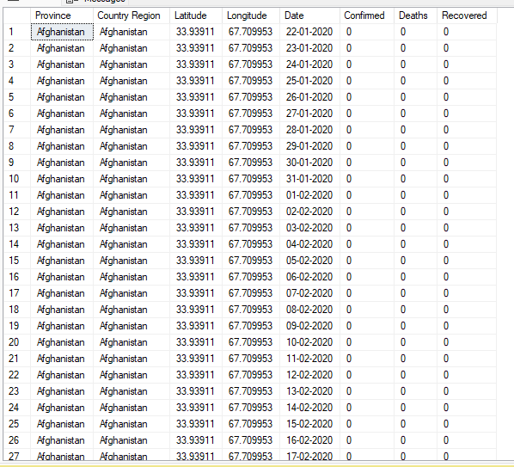
DATA OVERVIEW

Slide 6
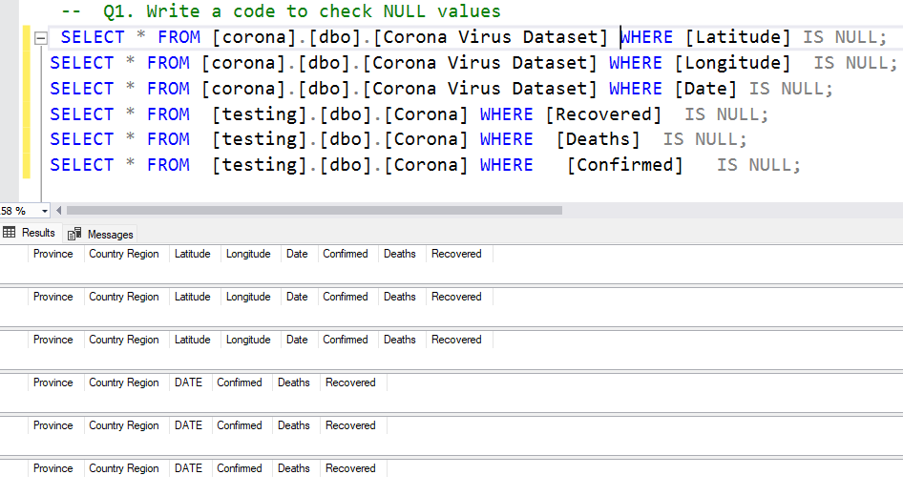
Check Null Values
There are no null values

Slide 7
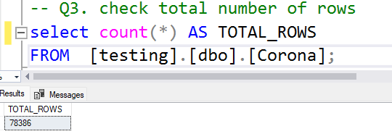
Total Number of Rows
Total Rows is 78386

Slide 8
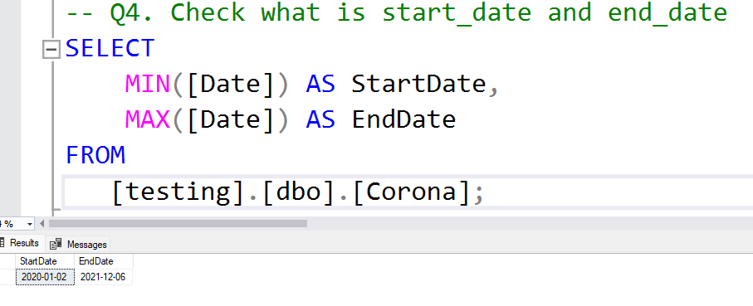
Start Date and End Date
Start date : 2020-01-02
End Date : 2021-12-06

Slide 9
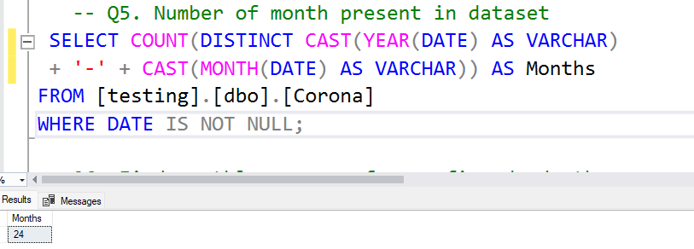
Number of Months Present in the Dataset
Total Months: 24

Slide 10
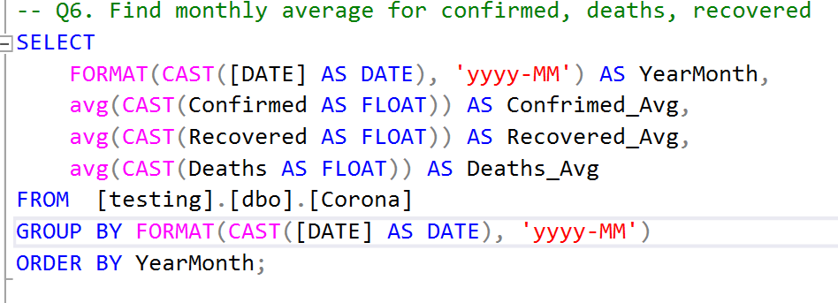
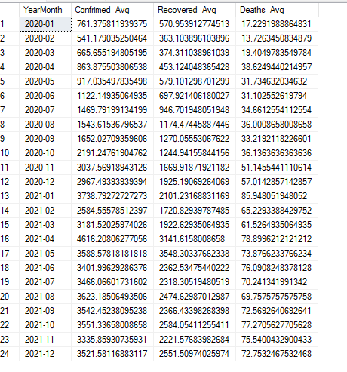
Monthly Average for Confirmed, Deaths and Recovered

Slide 11
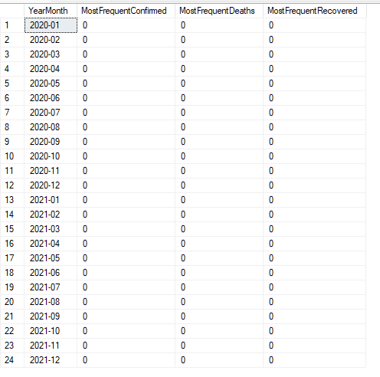
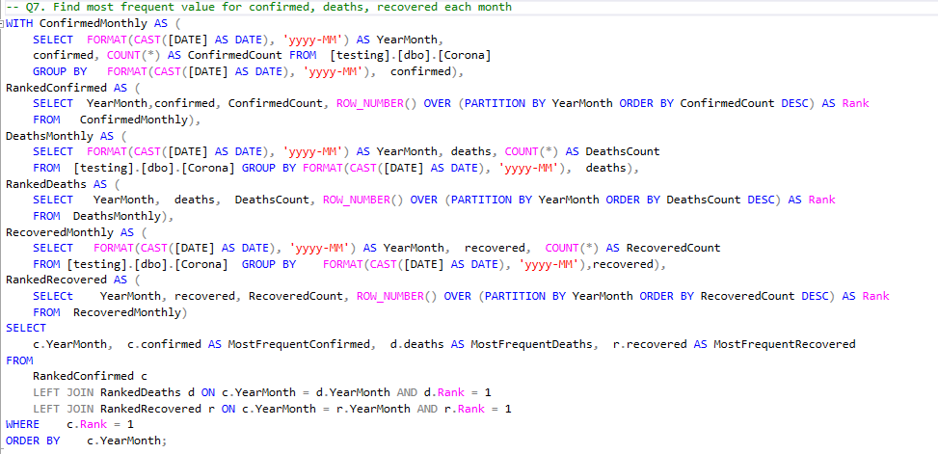
Most Frequent Value for Confirmed, Recovered and Deaths

Slide 12
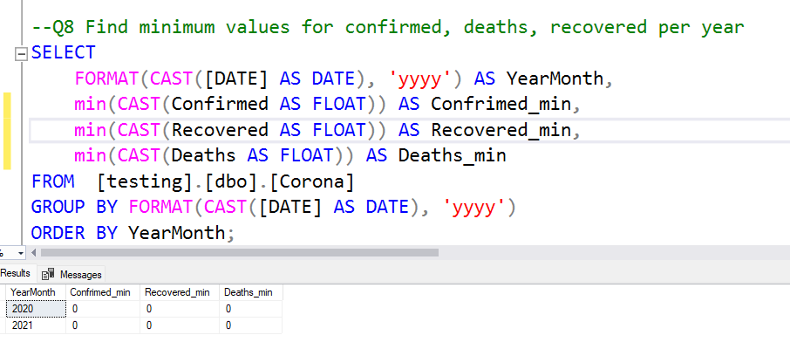
Minimum Values for Confirmed, Deaths and Recovered

Slide 13
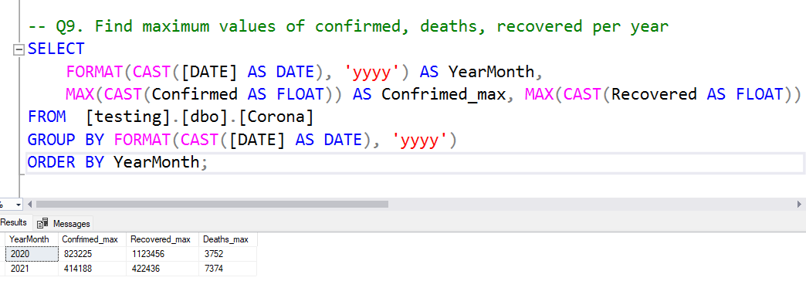
Maximum Values for Confirmed, Deaths and Recovered

Slide 14
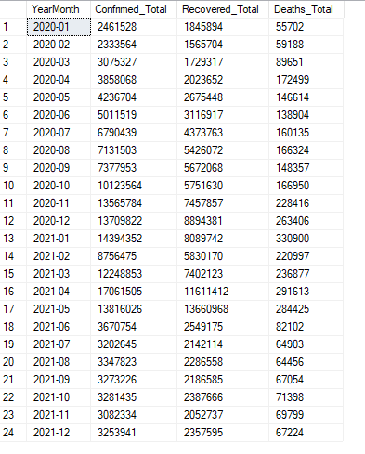
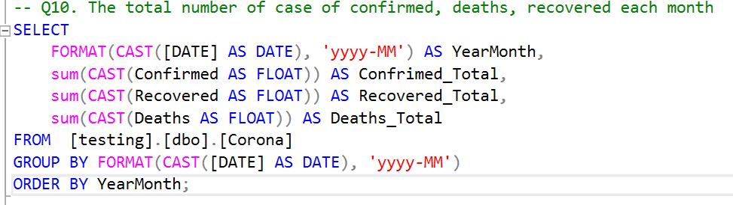
Total Cases Per Month for Confirmed, Deaths and Recovered

Slide 15
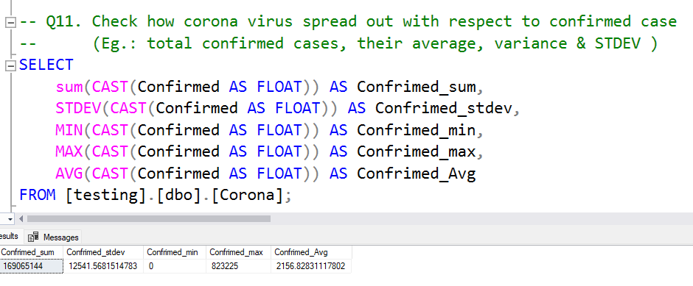
General Stats for Confirmed Cases

Slide 16
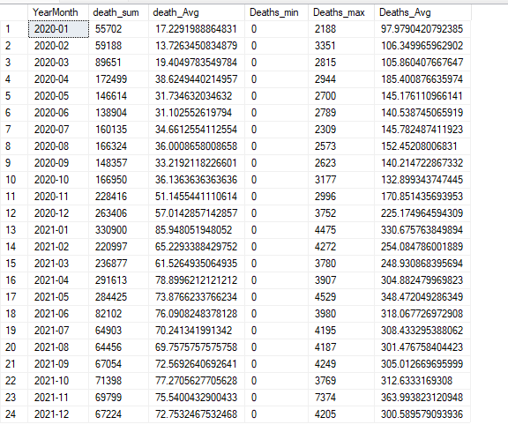
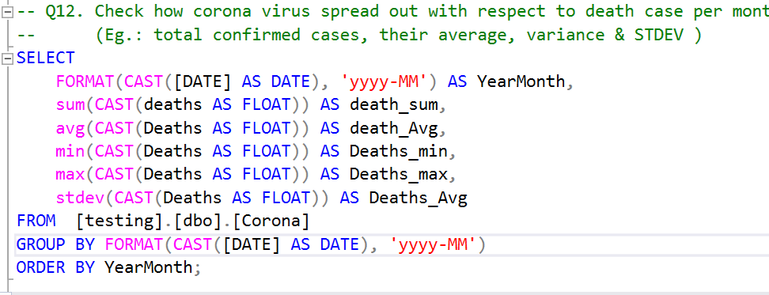
General Stats for Deaths Per Month

Slide 17
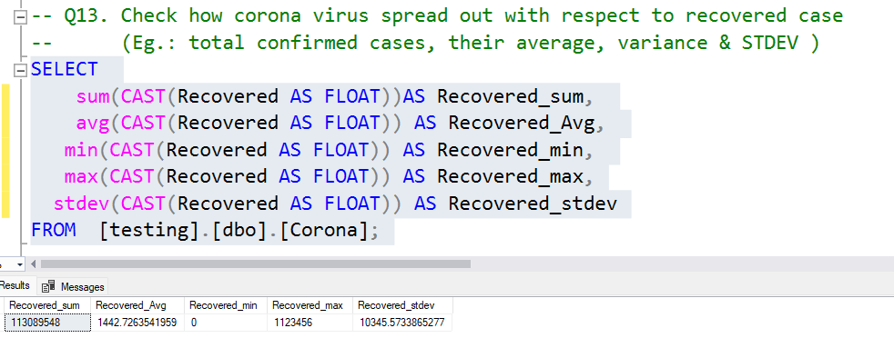
General Stats for Recovered Cases

Slide 18
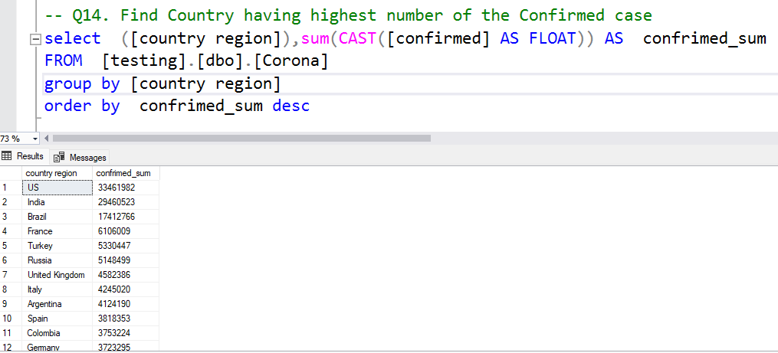
Most Confirmed Cases by Country

Slide 19
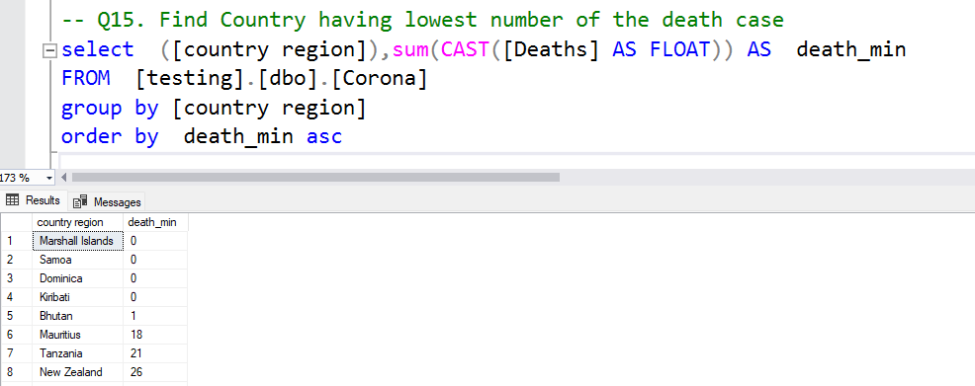
Least Deaths by Country

Slide 20
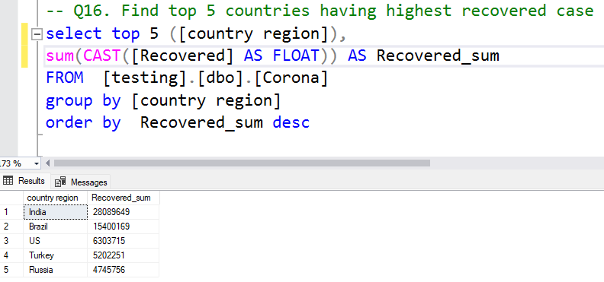
Top 5 Countries by Recovered Cases

Slide 21
KEY INSIGHTS GOTTEN FROM THE SQL ANALYSIS
Monthly Trends:
Monthly averages and most frequent values for confirmed cases, deaths, and recoveries to identify typical patterns and trends.
Annual Extremes:
Minimum and maximum values for confirmed cases, deaths, and recoveries per year to highlight periods of least and most impact.
Monthly Totals:
Total confirmed cases, deaths, and recoveries each month to track the spread and impact over time.
Statistical Distribution:
Analysis of total, average, variance, and standard deviation for confirmed, death, and recovered cases to understand the distribution and volatility.
Country-Specific Insights:
Countries with the highest confirmed cases, lowest death cases, and top 5 with the highest recovered cases to identify regional impacts and responses.

Slide 22
THANK YOU FOR WATCHING

